Slide 1
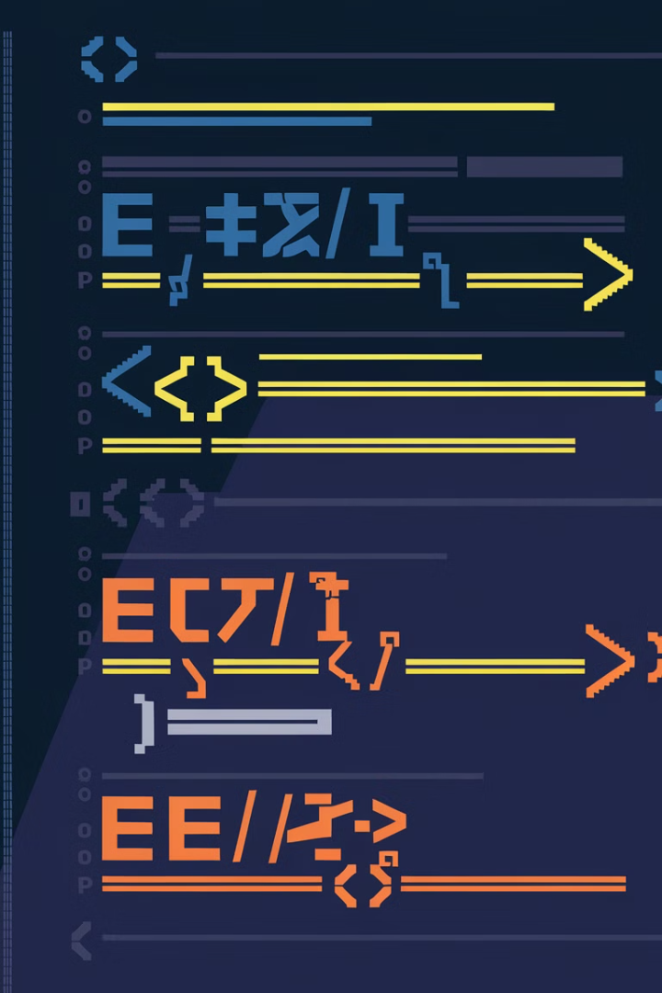
Strings in Python
Strings are a fundamental data type in Python, used to represent text. They are sequences of characters, enclosed in single or double quotes. Strings are immutable, meaning their contents cannot be changed after they are created.
my_string = "Hello, world!" print(my_string)
Python offers a wide range of operations for manipulating strings, including concatenation, repetition, and slicing. Strings can also be formatted using various methods, allowing developers to customize their appearance for specific purposes.
new_string = my_string + " This is an example." print(new_string)

Slide 2

Creating and Storing Strings
Strings are fundamental data types in Python, representing sequences of characters. You can create strings by enclosing text within single or double quotes.
For example, the following line assigns the string "Hello, World!" to the variable `greeting`.
greeting = "Hello, World!"
Here are some more examples:
name = "Alice"
city = "New York"
message = "The quick brown fox jumps over the lazy dog."

Slide 3


Measuring String Length
The `len()` Function
Example
The built-in function `len()` calculates the number of characters in a string. It takes a string as input and returns its length as an integer. This function provides a simple and efficient way to determine the size of a string.
For example, `len("Hello, world!")` returns 13, which is the number of characters in the string. This includes spaces and punctuation marks. Understanding string length is crucial when working with strings in Python.
>>> len("Hello")
5
>>> len("This is a longer string.")
22
>>> len("Hello, world!")
13
>>> len("Python is fun to learn!")
21

Slide 4

String Slicing and Joining
String slicing lets you extract specific portions of a string. Think of it like taking a slice from a pizza, but for text. You can access individual characters or larger substrings, defining the starting and ending points. String joining combines multiple strings into a single string, creating a larger whole. You specify a separator to join the strings together.
**Example: Slicing**
my_string = "Hello, world!"
substring = my_string[7:12] # Extracts "world"
print(substring) # Output: world
**Example: Joining**
parts = ["This", "is", "a", "joined", "string."]
joined_string = " ".join(parts) # Join using a space
print(joined_string) # Output: This is a joined string.

Slide 5
String Slicing and Joining
Extracting Substrings
The slice operator [start:stop:step] enables extracting specific parts of a string. It allows you to access a range of characters based on their indices. The `step` argument can be used to skip characters, providing a more granular control over the substring extraction. For instance, `my_string[2:7:2]` will extract characters at indices 2, 4, and 6.
my_string = "Hello, world!" substring = my_string[7:12] print(substring) # Output: "world"
my_string = "This is a string." substring = my_string[0:10:2] print(substring) # Output: "Ti sa"
Joining Strings
The `join()` method offers a convenient way to combine multiple strings. It takes an iterable of strings as input, and concatenates them with the specified delimiter. The delimiter is the string that is used to separate the concatenated strings. This is a powerful tool for building larger strings from smaller components. For example, `delimiter.join(list_of_strings)` would produce a single string with the delimiter separating each item from the list.
list_of_strings = ["Python", "is", "powerful"] delimiter = " " joined_string = delimiter.join(list_of_strings) print(joined_string) # Output: "Python is powerful"
list_of_numbers = ["1", "2", "3", "4"] delimiter = "-" joined_string = delimiter.join(list_of_numbers) print(joined_string) # Output: "1-2-3-4"

Slide 6
Searching and Replacing Within Strings
1
1. Finding Substrings
2
2. Replacing Substrings
3
3. Case-Sensitive Search
The find() method locates the first occurrence of a substring within a string. It returns the starting index of the substring if found, otherwise, it returns -1. The index() method performs a similar search but raises a ValueError if the substring is not present.
The replace() method is used to replace all occurrences of a specific substring with another. It returns a new string with the replacements made, leaving the original string unchanged.
The default behavior of find() and replace() methods is case-sensitive. If you need case-insensitive searching, use the lower() or upper() methods to convert both the string and the substring to the same case before performing the search.
my_string = "The quick brown fox jumps over the lazy dog."
my_string = "Hello World!"
my_string = "Hello world!"
new_string = my_string.replace("fox", "cat")
substring = "world"
index = my_string.find("world")
if my_string.lower().find(substring.lower()) != -1:
print(index) # Output: 6
print(new_string) # Output: The quick brown cat jumps over the lazy dog.
print("Substring found!")
else:
print("Substring not found.")

Slide 7

Formatting Strings
Formatting strings in Python allows you to control the presentation of text data. This includes aligning text, adding spaces, and inserting variables dynamically. For example, consider the following code snippet:
```python name = "Alice" age = 30 message = f"My name is {name} and I am {age} years old." print(message)
f-strings
f-strings provide a concise and readable way to embed variables and expressions directly into strings.

Slide 8
f-strings and Formatting
Here is an example:
name = "Alice"
age = 30
message = f"My name is {name} and I am {age} years old."
print(message)
This will print:
My name is Alice and I am 30 years old.
Formatting with f-strings
You can also use f-strings for formatting numbers, dates, and other data types.
Here is an example:
price = 19.99
formatted_price = f"The price is ${price:.2f}"
print(formatted_price)
This will print:
The price is $19.99

Slide 9

Escape Sequences
Escape sequences are special character combinations used to represent characters that are difficult or impossible to type directly. These sequences start with a backslash (\) followed by a specific character. They allow you to include characters like newline, tab, and quotation marks within strings without causing syntax errors.
For example, the code `print("This is a string with a newline character\n")` will print the text "This is a string with a newline character" followed by a new line.
Using escape sequences provides a way to incorporate these special characters into your strings without causing any problems. This ensures that your code functions correctly and your output is displayed as intended.
Here's another example: `print("This is a string with a tab character\t")` will print "This is a string with a tab character" followed by a tab character, which will create a horizontal space.

Slide 10

Escape Sequences
Escape sequences are special character combinations used to represent characters that are difficult or impossible to type directly. They begin with a backslash (\) followed by a specific character. For example, \n represents a newline, which creates a line break in your string.
Tab Character
Backslash Character
The \t escape sequence represents a tab character. It creates a horizontal space, typically used for aligning text in a structured format.
The \\ escape sequence represents a backslash itself. This is useful when you need to include a backslash literally within your string.
print("Hello\tWorld")
# Output: Hello World
print("The path is C:\\Users\\Documents")
# Output: The path is C:\Users\Documents

